Slide 1

20EC5203 ELECTRONIC DESIGN PROJECT- I MODULE 1-STRESS DETECTING SENSOR MODULE 2-– EMEGRENCY PATIENT ALARM
Presented by:
DURGA S (811722106024)
RETHNA GAYATHIRI M (811722106086)
VISHALINI B (811722106124)
Under the Guidance of
Mrs.V.Gowri M.E, Ph.d,.
Assistant Professor
ECE DEPARTMENT

Slide 2
OUTLINE
ABSTRACT –MODULE 1
INTRODUCTION
LITERATURE SURVEY
BLOCK DIAGRAM
CIRCUIT DIAGRAM
HARDWARE MODULE
ABSTRACT –MODULE 2
INTRODUCTION
LITERATURE SURVEY
BLOCK DIAGRAM
CIRCUIT DIAGRAM
HARDWARE MODULE
CONCLUSION
REFERENCES

Slide 3
MODULE 1 –STRESS DETECTING SENSOR

Slide 4
ABSTRACT - MODULE I
This project focuses on the creation of an advanced stress detection sensor to monitor stress
levels in real time, addressing the significant impact of stress on workplace productivity, publichealth, and human-machine interaction. The sensor uses physiological indicators such as skin temperature, cortisol levels, heart rate variability (HRV), and galvanic skin response (GSR) to assess stress. By employing signal processing and machine learning, it distinguishes between acute and chronic stress. The wearable, flexible system integrates micro-electromechanical systems (MEMS) for comfort and durability.Data is transmitted to a cloud platform for real-time processing and remote monitoring via IoT.

Slide 5
INTRODUCTION – MODULE 1
Stress is a pervasive issue impacting personal well-being and professional performance, with long-term effects like weakened immune systems, mental health disorders, and cardiovascular diseases.
As society becomes more aware of these negative impacts, the demand for effective stress monitoring methods grows. Traditional techniques like self-reported surveys and clinical interviews have limitations, such as subjectivity and lack of real-time feedback.
Stress involves complex interactions between the nervous, endocrine, and cardiovascular systems, with biomarkers like elevated heart rate and cortisol release.

Slide 6
OBJECTIVE & SCOPE
OBJECTIVES:
The primary objective of the stress-detecting sensor project is to develop an accurate, reliable, and user-friendly system that identifies and quantifies physiological indicators of stress.
This system aims to provide real-time stress monitoring, enabling early intervention, improving mental well-being, and supporting environments such as workplaces, healthcare, and personal wellness tracking.
SCOPE :
This comprehensive approach will ensure the stress-detecting sensor is technically advanced, user-focused, and adaptable to various environments, contributing to overall mental health and well-being.

Slide 7


LITERATURE SURVEY
Ref. No | Title & Author | Methodology or components used | Pros | Cons
1 | A smart sensor in the iomt for stress level detection Laavanya Rachakonda,Prabha sundaravadivel | Signal Acquisation and conditioning | A smart sensor in imot offers real time,non invasive,personalized stress detection | Smart sensors in imot may face challenges with data accuracy,privacy concerns,limted battery life.
2 | Sensor based identification of human stress levels | this data can be analyzed using computational models to detect and classify stress levels | Sensor based stress identification provides real time continuous monitoring | Sensor based stress identification can be intrusive and may ead to privacy concerns
3 | In situ stress and reliability monitoring on plastic packaging through piezoresistive stress sensor |  | Helps to identify underline heart condition early | Unnecessary anxiety, impacting carrier and mental health

Slide 8

LITERATURE SURVEY
4 | Sustainable wearables: Wearable technology for enhancing the quality of human lifeJaewoon Lee, Dongho Kim, Han-Young Ryoo | integrating eco-friendly materials, energy-efficient designs | improving quality of life through eco-friendly technology. | Technical limitations in materials and energy efficiency and costly.
5 | Data for life: Wearable technology and the design of self-careNatasha Dow Schüll | Personalized health monitoring, and real-time data feedback to promote autonomy in health management | To take control of their health through personalized data and self-care insights. | It may lead to information overload and increased anxiety about health metrics for some users.

Slide 9
BLOCK DIAGRAM
230 volts AC power supply
Input through Touch Pads
Output stress level indication
Transformer
Regulated power supply
Dot/Bar Display Driver
High stress level indicator

Slide 10
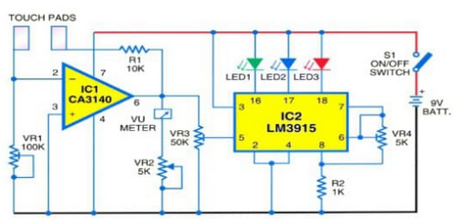
CIRCUIT DIAGRAM

Slide 11
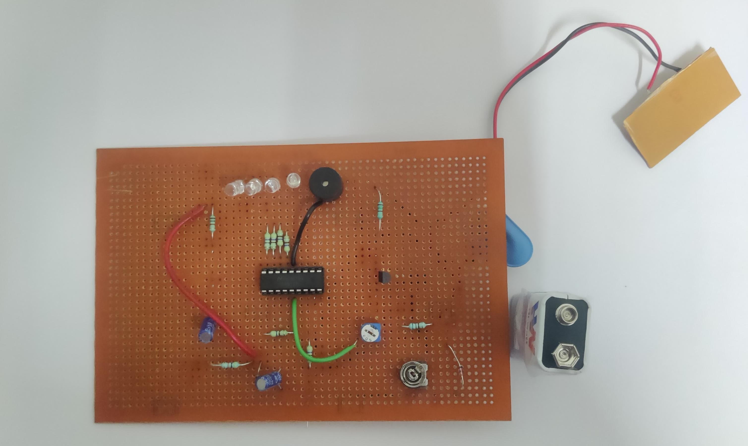
HARDWARE MODULE
LINK : https://go.screenpal.com/watch/cZle10nnhac

Slide 12
HARDWARE MODULE
Stress-detecting sensors rely on a combination of advanced hardware components to measure physiological and environmental changes in real-time. These sensors typically include a microcontroller to process data and manage device functions.
A key component is the sensor module, which may incorporate heart rate monitors, skin conductivity (GSR) sensors, and temperature sensors to track physiological responses like pulse, sweat levels, and body heat.
Some systems also integrate accelerometers to detect motion and posture, which can indicate physical stress. The hardware often features wireless connectivity modules like Bluetooth or Wi-Fi to transmit data to external devices for further analysis.
Power-efficient designs use rechargeable lithium-ion batteries or energy harvesting mechanisms to ensure long-lasting operation.

Slide 13
MODULE 2 – EMEGRENCY PATIENT ALARM

Slide 14
ABSTRACT - MODULE 2
This project introduces an Emergency Patient Alarm System designed to enhance patient safety and ensure timely medical intervention in hospital environments. When a patient touches a strategically placed sensor, it triggers an audible buzzer and sends a digital alert to designated healthcare staff, ensuring a rapid response. The system features a touch-sensitive sensor that requires minimal effort, making it accessible for patients with limited mobility, such as the elderly or those recovering from surgery. Positioned within easy reach, it fosters a sense of security and autonomy for patients and provides peace of mind for their families, ensuring that help is always readily available.

Slide 15
INTRODUCTION – MODULE 2
In modern healthcare settings, patient safety and timely medical responses are essential. The Emergency Patient Alarm System addresses this need by providing an intuitive, touch-sensitive sensor that patients can activate effortlessly in emergencies.
When touched, the system triggers a loud buzzer to alert nearby medical staff and sends a digital notification to the assigned doctor or nurse.
This dual-alert mechanism ensures rapid response times and enhances patient autonomy. By improving communication between patients and caregivers, it reduces overlooked or delayed responses, optimizing workflow efficiency.

Slide 16
OBJECTIVE & SCOPE
OBJECTIVES:
The primary objective of the Emergency Patients Alarm Project is to develop a reliable, real-time alert system for healthcare facilities.
This system ensures that critical medical personnel are promptly notified about emergencies involving patients who require immediate attention, improving response times and patient outcomes.
SCOPE:
Connect with existing patient monitoring systems to detect critical conditions such as sudden changes in vital signs (e.g., heart rate, blood pressure).
Generate instant notifications through multiple channels, including mobile apps, pagers, and hospital PA systems, ensuring immediate communication.

Slide 17
LITERATURE SURVEY
Ref. No | Title & Author | Methodology or components used | Pros | Cons
1 | Enhancing the quality of life through wearable technology Sungmee Park, Sundaresan Jayaraman | Enhancing quality of life through wearable technology involves integrating advanced health monitoring, personalized feedback, | personalized insights, improving overall well-being. | security risks arise from continuous tracking and data collection.
2 | A survey on patient technology: History, state-of-the-art and current challenges Aleksandr Ometov, Viktoriia Shubina, | The methodology for a patient technology survey involves reviewing its history, analyzing current advancements | A comprehensive survey provides insights into technological evolution, current innovations | It may quickly become outdated due to the rapid pace of advancements in wearable technology.

Slide 18
3 | Advances in technology and applications in physical medicine and rehabilitationPaolo Bonato | Reviewing innovations, analyzing clinical applications, and assessing effectiveness through trials and case studies. | Patient alarm technology enhances rehabilitation by providing real-time feedback and personalized therapy. | High costs and limited accessibility
4 | Zhang, Y., Liu, S., & Li, X. (2020). Emergency patient alarm system using wearable health monitoring devices. | Data from these sensors is processed through a microcontroller, which triggers an alarm if vital signs indicate an emergency. | Real-time monitoring and alert transmission | Dependent on sensor accuracy and battery life.

Slide 19
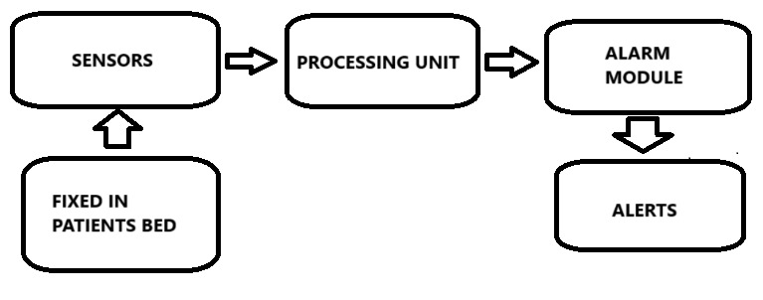
BLOCK DIAGRAM

Slide 20
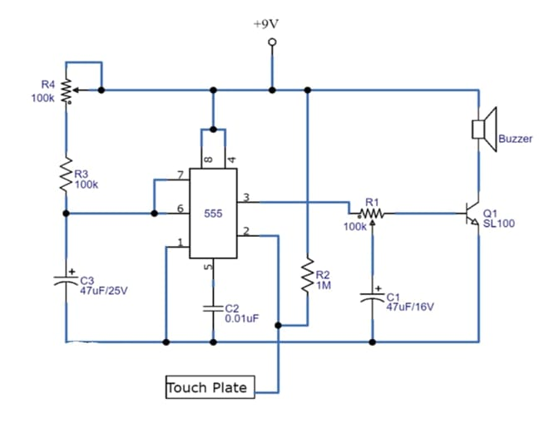
CIRCUIT DIAGRAM

Slide 21
HARDWARE MODULE
The Emergency Patient Alarm System hardware module is designed to ensure patient safety and facilitate rapid medical intervention in healthcare settings. At its core, the system comprises a touch-sensitive sensor, a microcontroller, an audible buzzer, and a communication module.
The touch-sensitive sensor, often placed on bed railings or bedside tables, allows patients to activate the alarm with minimal effort, making it particularly useful for those with limited mobility.
When the sensor is touched, the microcontroller processes the input signal and triggers a loud buzzer to alert nearby medical staff.
Simultaneously, the communication module transmits a digital notification to designated healthcare providers, such as doctors or nurses, ensuring that assistance is dispatched promptly.

Slide 22
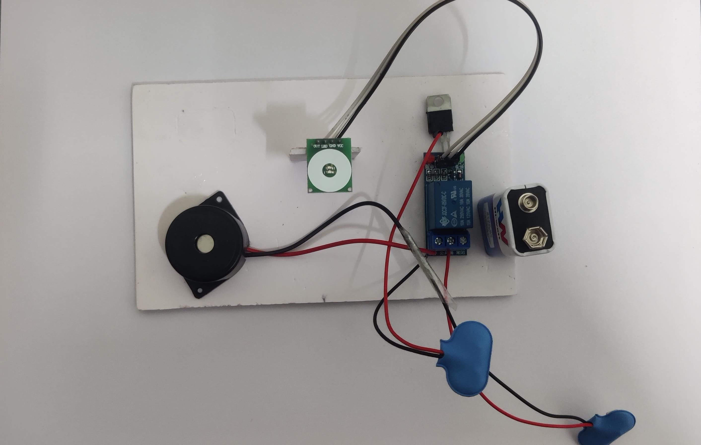
HARDWARE MODULE
LINK : https://go.screenpal.com/watch/cZle1OnnhaA

Slide 23
CONCLUSION
The stress-detecting sensor utilizes advanced physiological monitoring technology to assess a patient's stress levels in real-time.
It measures key indicators such as heart rate variability, skin conductivity, and perhaps even cortisol levels, translating these data points into a simple yet effective visual display.
The LED system offers an intuitive method for both patients and healthcare providers to gauge stress levels at a glance.
When light stress is detected, a single LED blinks, providing a subtle but clear indication. This early warning allows for immediate self-care or intervention, potentially preventing the escalation of stress into more serious health concerns.

Slide 24
REFERENCES
Abugabah, A., & Alfarraj, O. (2019). Healthcare systems and technology developments: A systematic review. Applied Sciences, 9(13), 2615.
Can, Y. S., Arnrich, B., & Ersoy, C. (2019). Stress detection in daily life scenarios using smartphones and wearable sensors: A survey. Journal of Biomedical Informatics, 92, 103139.
Choi, J. M., Ahmed, B., & Gutierrez-Osuna, R. (2012). Development and evaluation of an ambulatory stress monitor based on wearable sensors. IEEE Transactions on Information Technology in Biomedicine, 16(2), 279-286.
Gjoreski, M., Luštrek, M., & Gams, M. (2016). Accelerometer placement for posture recognition and fall detection. Sensors, 16(4), 476.
Hernandez, J., Li, Y., & Picard, R. W. (2014). BioWatch: Estimation of user’s mental workload using EEG and heart rate variability. Proceedings of the 2014 ACM International Joint Conference on Pervasive and Ubiquitous Computing, 139-150.

Slide 25
6. Kim, H. G., Cheon, E. J., Bai, D. S., Lee, Y. H., & Koo, B. H. (2018). Stress and heart rate variability: A meta-analysis and review of the literature. Psychiatry Investigation, 15(3), 235-245.
7.Sharma, N., & Gedeon, T. (2018). Objective measures, sensors and computational techniques for stress recognition and classification: A review. Computer Methods and Programs in Biomedicine, 146, 139-157.
8. US Patent No. 10,584,375: Method and System for Real-Time Stress Detection.
9. Provides insights into sensor-based stress detection methods, J. A., & Picard, R. W. (2005). Detecting stress during real-world driving tasks using physiological sensors. IEEE Transactions on Intelligent Transportation Systems, 6(2), 156-166.
10.Zhang, Y., Liu, S., & Li, X. (2020). Emergency patient alarm system using wearable health monitoring devices.

Slide 26
THANK YOU

